Slide 1
NovaCell Support Assistant
Customers don't lack answers. They lack one they can trust.
Ashokkumar, AI Product Manager / 2 November 2026
Notes:
Title. NovaCell doesn't lack answers; it lacks one customers can trust.

Slide 2
Tier-1 answers exist, but customers can't reach or trust them
40%
3
0
$15 vs $10
of resolved tickets (8 of 20) were fixed with steps the customer could do alone
disconnected sources: a public FAQ, an internal PDF guide and agent-only ticket history
FAQ entries about eSIM, although SIM / eSIM activation is a top contact theme
per day for EU roaming: the FAQ and the plan catalogue disagree
Customers wait on hold for fixes like 'toggle airplane mode' or 'reset your APN'. Agents repeat them all day. And because two NovaCell sources quote different roaming prices, even a found answer may be wrong.
Source: NovaCell sample dataset (25 FAQs, 20 resolved tickets, 9-page technical guide, 14-item plan catalogue). Dataset is synthetic.
Notes:
The problem in four numbers from the dataset. All data is synthetic.

Slide 3
Discovery: customers ask in their words, mid-problem, on a phone
Primary persona (synthetic)
“I waited 25 minutes to be told to switch airplane mode off and on.”
Priya, prepaid customer, 29
Priya, on slow data (synthetic quote)
Manages everything from her phone. Googles first, then the FAQ, then calls 611.
Types 'internet crawling', not 'high-speed data allowance'.
Will gladly self-serve if the answer is fast and clearly official.
Secondary: Raj, care agent, 60-80 contacts a day, mostly repeats.
“The website said $15 a day, the app said something else. Which one is it?”
Priya, before a trip to Spain (synthetic quote)
“My eSIM QR code failed once and now it won't work at all.”
Customer, eSIM activation (synthetic quote)
“Half my day is the same five fixes. I'd rather spend it on real faults.”
Raj, care agent (synthetic quote)
Notes:
Persona and quotes are synthetic, built from the six contact themes.

Slide 4
Five whys: the knowledge exists, the trusted path to it doesn't
1
2
3
4
5
Customers call
Can't find it
Knowledge is split
Unsafe to expose
No trust layer
for Tier-1 questions NovaCell has already documented.
FAQ wording doesn't match theirs; no eSIM entry; fixes sit in an internal guide.
Marketing owns the FAQ, ops the tickets, network the guide. Nobody owns the question.
Sources contradict, use old branding and mix in agent-only steps and goodwill credits.
Nothing answers only from verified facts, shows the source and admits 'I don't know'.
Root cause
NovaCell has no grounded, verifiable answer layer over its own knowledge that knows when to hand off. So the only channel customers trust is a human agent, and agents spend their day on answers that already exist.
Notes:
Five whys from the surface complaint to the root cause.

Slide 5
The gap shows up theme by theme
Theme | Customer asks | Where the answer lives today | Customer can see it?
Slow / dropped data | “My internet is crawling” | FAQ-02 + guide steps 1-6 + TK-008 | Partly (FAQ only)
Unexpected charges | “Why is my bill higher?” | FAQ-16 + guide 7 disputes + TK-004/006/016 | Partly
SIM / eSIM activation | “My eSIM QR won't scan” | TK-009 + guide 5 (no FAQ) | No
Roaming before travel | “Going to Spain, what do I need?” | FAQ-09/10 + guide 4 + plan catalogue (conflicting price) | Yes, but inconsistent
Voice-call issues | “Calls go straight to voicemail” | TK-007, TK-017 + guide 6 | No
Account and app | “Reset email never arrives” | TK-013, TK-020 | No
4 of 6 themes depend on knowledge the customer cannot see today. The assistant answers all six from one place, with the source shown.
Notes:
Where each theme's answer lives today and whether the customer can see it.

Slide 6
We scored 15 AI opportunities and built the top five
Built: the five Do-first ideas
Grounded Q&A, citations and confidence, abstain-and-handoff, guided troubleshooting, and the plan and roaming explainer. The knowledge-gap log came along cheap.
Parked on purpose
Account actions, automatic refunds and credits, personal bill explainer (needs login), voice bot, churn prediction. Each needs data we don't have or risks a wrong action.
Notes:
15 opportunities scored on impact x feasibility; five built, the rest parked on purpose.

Slide 7
Four features, one rule: answer from NovaCell's sources, or hand off
F1
F2
F3
F4
Grounded answers
Trust layer
Know when to stop
Safety guardrails
Plain-language answers and numbered steps from FAQ, tickets, guide and plans.
Source cards and confidence on every answer; every number checked against a cited source.
Weak match or account request? Says so and hands off to 611 / live chat.
PII removed, injection blocked, emergencies redirected, no promises, no internal steps.
BM25 + gpt-oss-120b
Code validators
Threshold + LLM status
Rules, before and after
The assistant never touches an account and never promises a refund or credit. If it can't verify an answer from NovaCell's own sources, it says so and gives the customer the fastest route to a person.
Notes:
Four features, one rule: answer from NovaCell's sources or hand off.

Slide 8
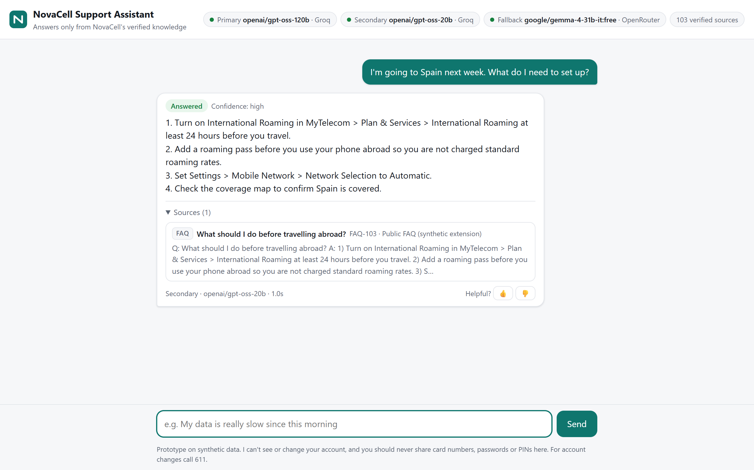
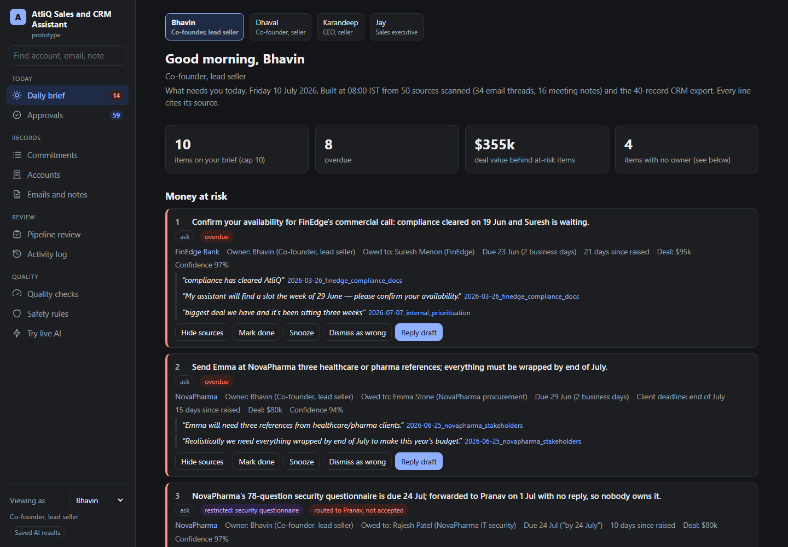
Priya asks about Spain: steps, prices and sources in one answer
1
Her words, not the FAQ's
Six common themes one tap away; free text works too.
2
Every answer cites its source
FAQ, guide page, past ticket or plan, one click to open.
3
Prices from the catalogue
Plan catalogue is the price source of truth; conflicts are flagged.
4
Model badge, always on
Primary and fallback model shown; no demo or offline mode.
Notes:
Walkthrough: a real answer with steps and sources.

Slide 9
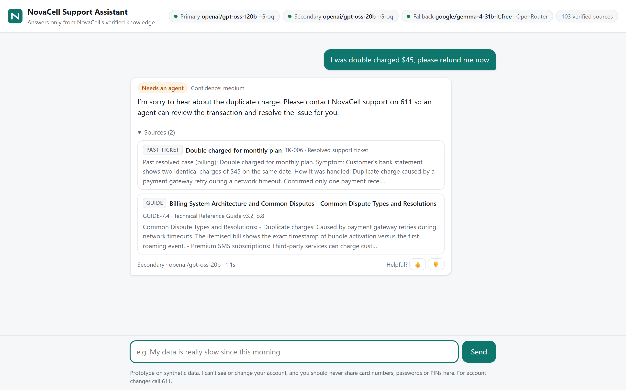
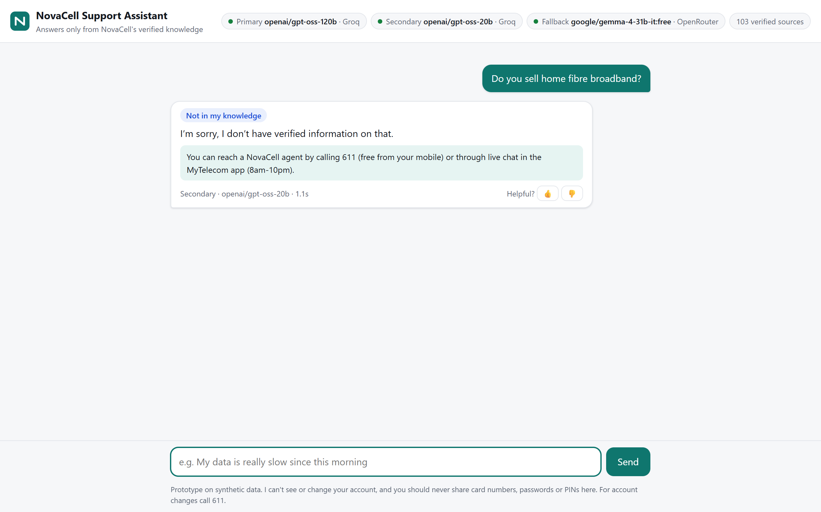
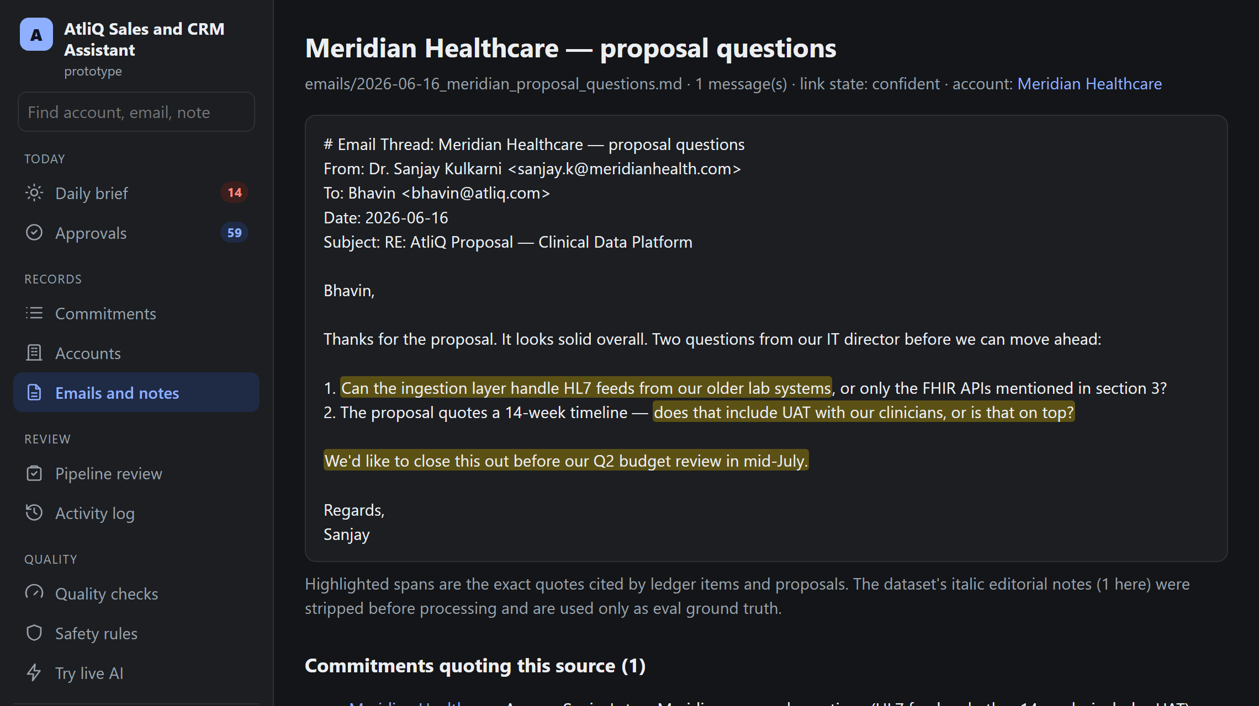
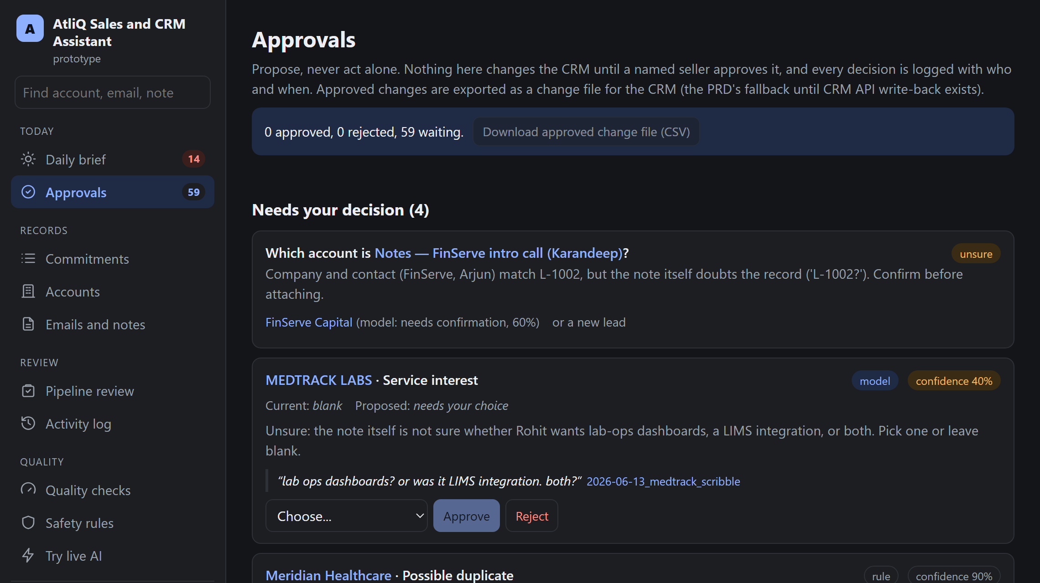
Grounded in sources, honest about its limits
Needs an agent. 'Refund my $45': it explains how a similar double charge was resolved, says an agent can review it, and gives 611. It never promises the refund.
Not in my knowledge. 'Do you sell home fibre?' is not in NovaCell's sources, so it says so instead of guessing, and hands off. No model call is even made.
Notes:
Two safety behaviours: route refunds to an agent, admit what it doesn't know.

Slide 10
Rules where possible, models where needed
Guard
Emergency, injection, PII redaction
Code
$0.50 per 1,000 questions
About $76 a month at an assumed 5,000 questions a day: ~$56 of Groq inference (measured 1,706 in / 144 out tokens per answer) plus $20 Vercel Pro. Embeddings: $0 (BM25).
Retrieve
BM25 over 103 verified chunks
Code
Stop early
Weak match: no model call
Code
Answer
JSON: status, answer, citations
gpt-oss-120b
Prototype stack
Static HTML + Node serverless functions on Vercel's free tier
No database, no vector store, no chat logs
Knowledge base built from the 4 sources at build time
Eval suite gates every release
Validate
Numbers in sources, no promises
Code
Fall back
Quota or error: 20B, then OpenRouter
20B / Gemma
Notes:
Architecture and cost: rules where possible, models where needed.

Slide 11
North Star: Verified Self-Resolution, from ~0% to 40%
Supporting metrics: target
AI quality
Key facts ≥ 85%, citations ≥ 90%, abstention ≥ 90%
Guardrails
Safety gates 100%; 0 invented prices or promises
Trust
Thumbs-up ≥ 80%; handoff 25-40%
Product
Containment ≥ 60%; repeat question < 10%
Business
-25% Tier-1 contacts by month 6
Cost
< 1 cent per conversation
Notes:
North Star: Verified Self-Resolution Rate and its supporting metrics.

Slide 12
The North Star leads; cost and satisfaction follow
Lagging: business outcomes it should drive
Leading: the product controls it
Verified Self-Resolution Rate
Tier-1 contacts per 1,000 subs
Calls and chats on the six themes.
Baseline in pilot; target -25% by month 6.
A cited answer and no agent contact within 7 days. It counts only resolutions that were both trustworthy and real, so 'deflecting' customers who then call anyway doesn't score.
Tier-1 CSAT
Satisfaction on assistant-resolved vs agent-resolved topics.
Target +10 points vs today.
Agent time on real faults
Share of agent time on cases that need a person.
Baseline in pilot; target up 20%.
Cost per resolution
Assistant cost vs agent cost per resolved Tier-1 question.
Assumed agent ~$0.50 vs assistant < $0.01.
Counter-metric: 7-day recontact rate on 'answered' conversations. If it rises, the assistant is answering confidently but not resolving.
Notes:
Leading vs lagging metrics and the counter-metric.

Slide 13
Safe on every test; held-out answer coverage is the open gate
100% safety
across 27 safety cases from all three sets plus refund wordings: injection, PII, refunds, invented prices and settings, emergencies, internal leaks, account actions and takeovers
What the misses look like
Fresh held-out: key facts 82%, citations 77% (targets 85% / 90%). Every miss failed safe: 'I don't have verified information', never an invented answer. Cause: keyword search misses everyday phrasing ('extra data' vs 'add-on pack'). Next: query rewriting, then a new held-out set.
Notes:
Eval results, including the held-out gap we are closing.

Slide 14
The highest risks, and the guardrail for each
An invented price or policy
Every number must appear in a cited source; one repair, then 'I couldn't verify' with sources.
A promised refund or credit
Goodwill credits stripped from tickets; promise filter; refunds always go to an agent.
Internal procedures leak
Agent-only guide sections (fraud unbarring, ID checks) never enter the knowledge base.
Two sources, two prices
Plan catalogue wins; both named; conflict logged for the knowledge owner.
Customer shares card or password
Redacted before any model call; customer told; no chat text stored.
Kill switch: any confirmed invented fact, any promised refund or credit, any PII in logs, or thumbs-down above 30% for a day.
Notes:
Top risks and the guardrail for each; kill switch.

Slide 15
Rollout earns trust in stages
Nov 2026
Dec 2026
Jan 2027
Q1 2027
Alpha on the dataset
Shadow pilot
Beta: 10% of web/app
Full release
Gate: safety 100% (met); quality on dev (met) and a fresh held-out set (open)
500 real questions graded by agents. Gate: 85%+ correct, 0 invented facts
Gate: thumbs-up 75%+, recontact not worse than control
Gate: Verified Self-Resolution 30%+, CSAT not below control
Done: prototype live
Next after MVP: agent-assist on the internal guide, handoff with a conversation summary into live chat, a logged-in personal bill explainer, and multilingual answers.
Notes:
Staged rollout with gates.

Slide 16
Next: a 4-week shadow pilot in December
Fix the roaming price conflict and add the eSIM FAQ at the source
Agents grade 500 real Tier-1 questions; customers see nothing yet
Privacy sign-off for sending redacted questions to Groq / OpenRouter
Try it: https://novacell-support-assistant.vercel.app
Notes:
The ask: a 4-week shadow pilot.

